Slide 1
Spatial Informatics Final Presentation
Name: Ansh Chablani
Roll No.: 2022111031

Slide 2

Title and Description
Title: Optimal Trajectory Planning for a Mars Rover Using Spatial Data collected by Mars Orbiters
Description: This project aims to plan an optimal trajectory for a rover traveling between two selected sites. The rover trajectory is optimized by considering terrain difficulty, obstacles, and energy consumption constraints.

Slide 3
Objectives Achieved

Slide 4
Objectives Achieved
These are the objectives I achieved till mid evaluation.
Find and establish a suitable CRS for Mars. (CRS = Coordinate Reference System)
Find necessary data and extract out useful information from them.
Using a DTM of a particular region of Mars, find a suitable movement directions given a start point based on only the slope data. (dropped this method in the final submission)
Using the movement directions and the slope data, establish a means of finding a least cost trajectory given a start point. This establishes a good base over which I can put more constraints. (dropped this method in the final submission)

Slide 5
Objectives Achieved
These are the objectives I achieved after mid evaluation.
Implement a custom algorithm to find the shortest path from a start point and an end point.
Include checks and route the rover away from danger zones. Inculcate danger zones – deep craters, big rocks.
Affinity points: Include “via” points which need to be visited however from a distance. E.g. Craters, ice deposits, etc.
Inclusion and processing of the CRISM dataset. This includes identification of high concentration of ice deposits using image processing of a raster. This includes thresholding, morphological operations and Hough Circles.
3D visualiser for the HiRISE dataset with the path overlayed in 3D.

Slide 6
Objectives Achieved
These are the objectives I achieved after mid evaluation.
6. A simple robot that traverses the terrain.
7. *Accounting for local slope gradient. E.g., if the rover has a physical constraint of a tolerance of 30 degrees to climb a slope, it will only follow a trajectory that satisfies this constraint.

Slide 7

Implementation of the Path Planning Algorithm
A DTM is a raster who's each pixel holds a value / some values. Usually the first (and only) value is the elevation of a point on the DTM.
High Resolution DTM are larger. Large enough that it theoretically takes my machine about thirty minutes to generate a brute-force graph (using pairs) for a 70 𝑚 ∗ 70 m.

Slide 8
Implementation of the Path Planning Algorithm
This brute force method makes large scale computation slower but gives the same.
The idea is to implement a dense graph of the same size as the DTM however with a different shape.

Slide 9
Implementation of the Path Planning Algorithm
Val
Val
Left Cost
Top Cost
Right Cost
Bottom Cost

Slide 10
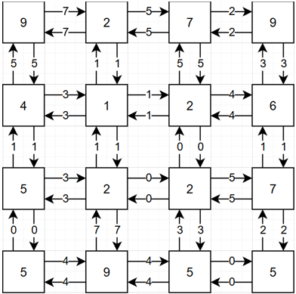
Implementation of the Path Planning Algorithm
Val
Val
Left Cost
Top Cost
Right Cost
Bottom Cost

Slide 11
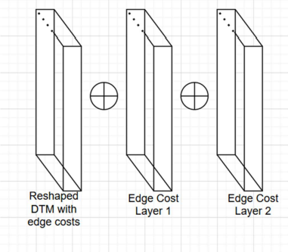
Combining two “weights layer”
The code to compute the trajectory relies on weights layers.
These have the edge costs to be added.
All computation is vectorized and be simply superimposed using some function, most simply addition.

Slide 12
Now we have the nodes and the edges costs

Slide 13
We would apply Dijkstra to calculate the optimal path. (All edges costs are constrained to non-negative numbers)

Slide 14
Avoiding Danger Zones
The code to compute the trajectory relies on weights layers.
These have the edge costs to be added.
All computation is vectorized and be simply superimposed using some function, most simply addition.

Slide 15
Affinity Points
The code to compute the trajectory relies on weights layers.
These have the edge costs to be added.
All computation is vectorized and be simply superimposed using some function, most simply addition.

Slide 16
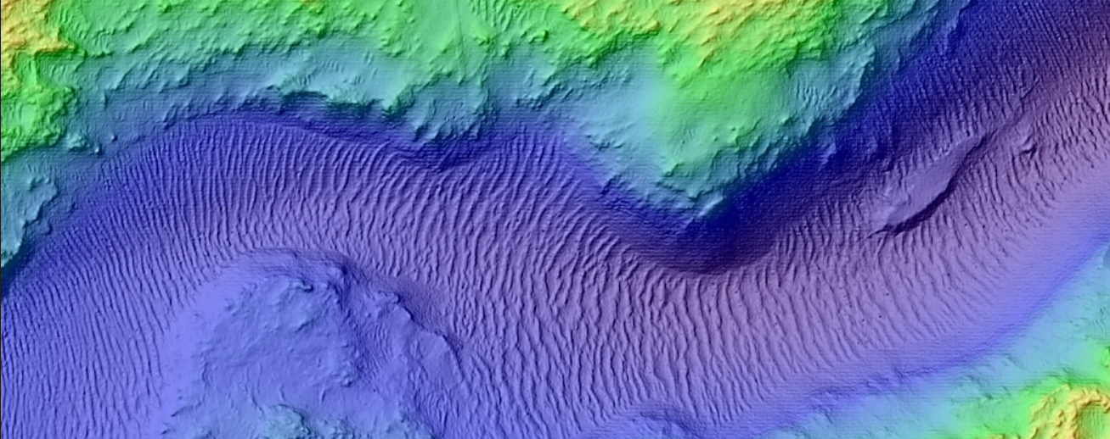
Processing Raster Data from CRISM Dataset Using Image Processing
Let’s look at this beautiful image of a region in Mars at the coordinates: 18.69° 𝐿𝐴𝑇, 78.15° 𝐿𝑂N

Slide 17
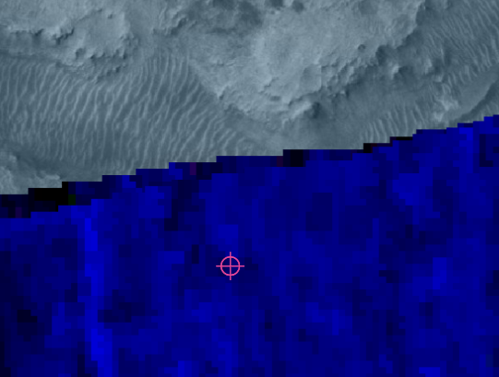
CRISM Data for ICE deposits
Let’s look at this beautiful image of a region in Mars at the coordinates: 18.69° 𝐿𝐴𝑇, 78.15° 𝐿𝑂N

Slide 18
CRISM Data for ICE deposits
The ice deposits layer is in blue.

Slide 19
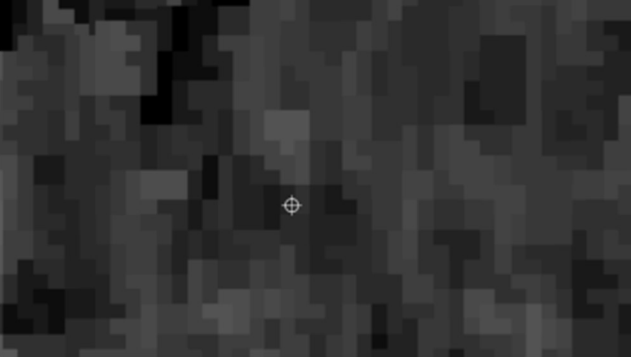
CRISM Data for ICE deposits
Grayscale version of the image

Slide 20
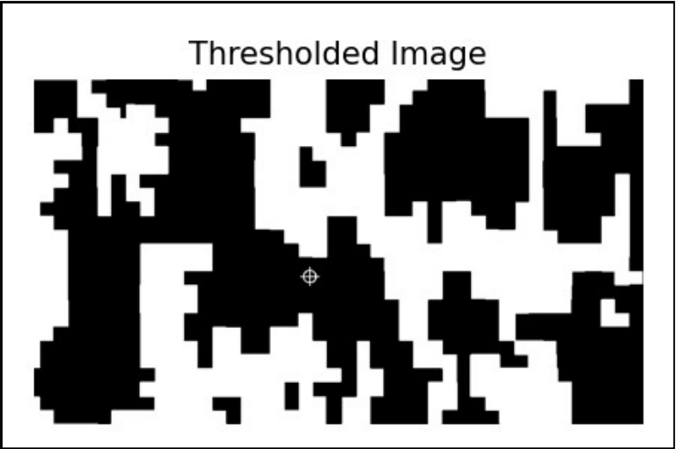
Image Processing of CRISM data: Step 1
Threshold applied on the image to get the significant regions.

Slide 21

Image Processing of CRISM data: Step 2
Closing morphological operation applied to get significant clusters

Slide 22
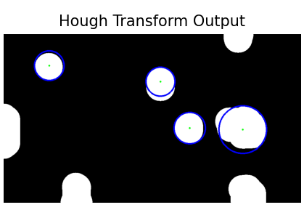
Image Processing of CRISM data: Step 3
Hough Circles applied to get the coordinates.

Slide 23
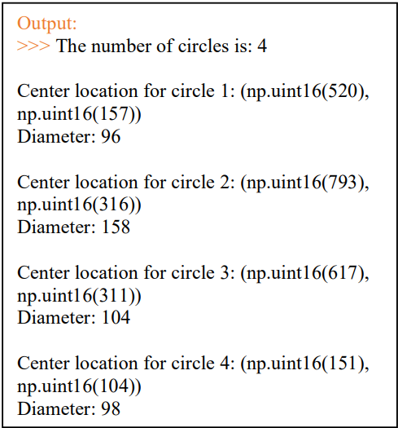
Image Processing of CRISM data: Step 3
Hough Circles applied to get the coordinates.

Slide 24
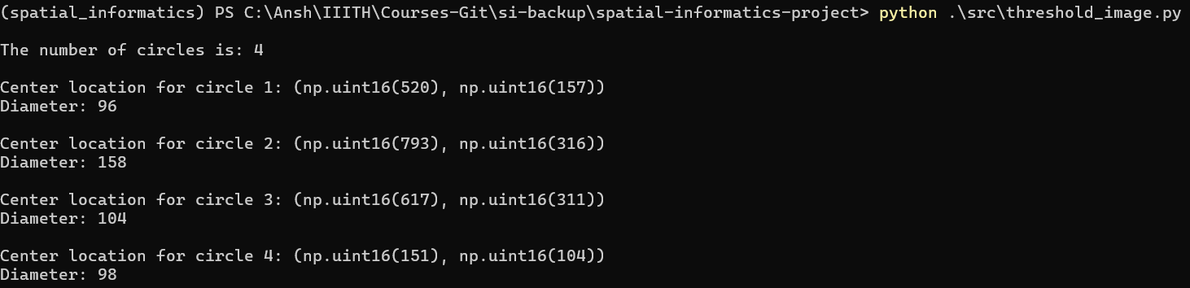
Image Processing of CRISM data: Step 3
Hough Circles applied to get the coordinates.

Slide 25
3D Visualizer!!

Slide 26
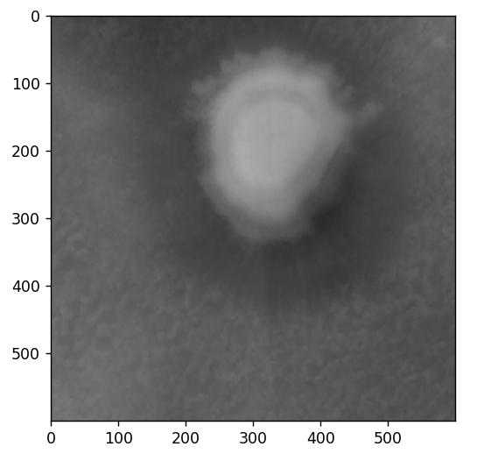
A 3D visualizer to visualize the DTM and the path generated.

Slide 27
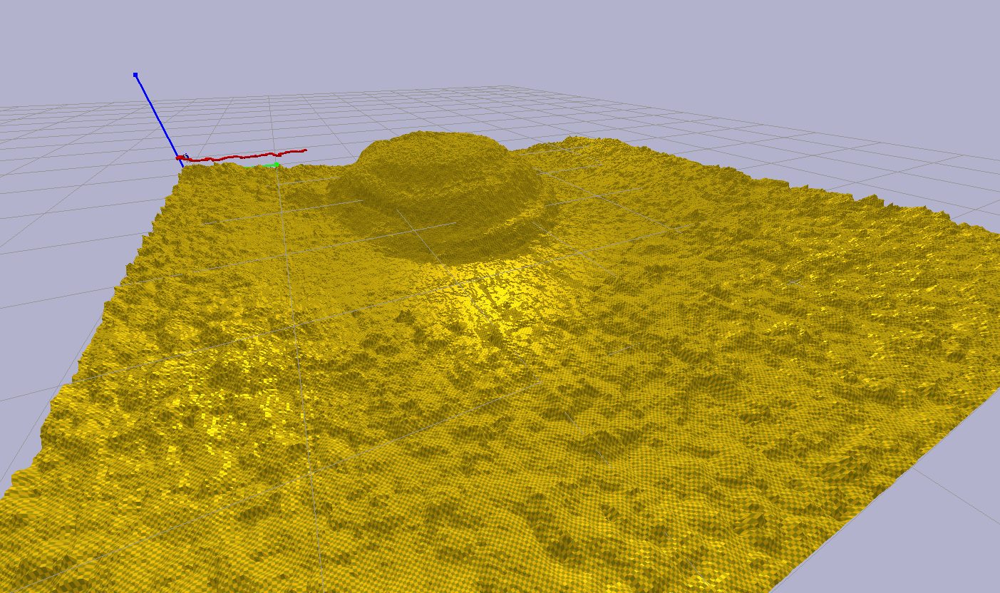
A 3D visualizer to visualize the DTM and the path generated.

Slide 28
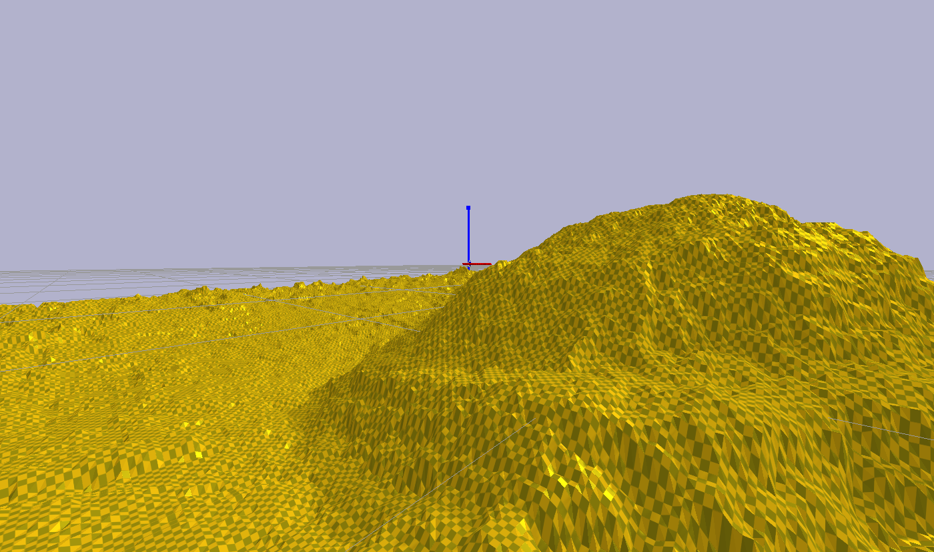

Slide 29
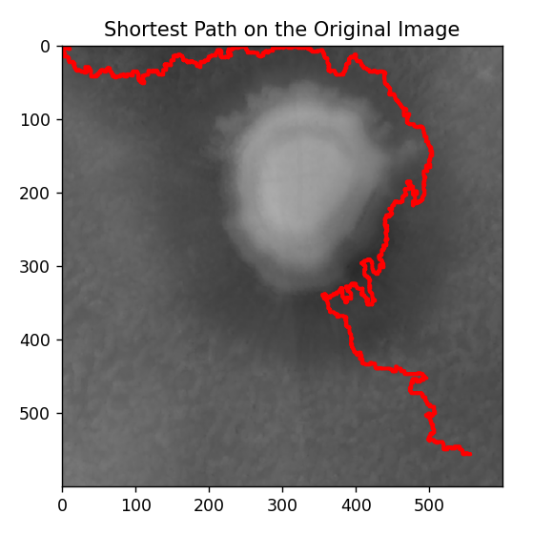
Path generated

Slide 30
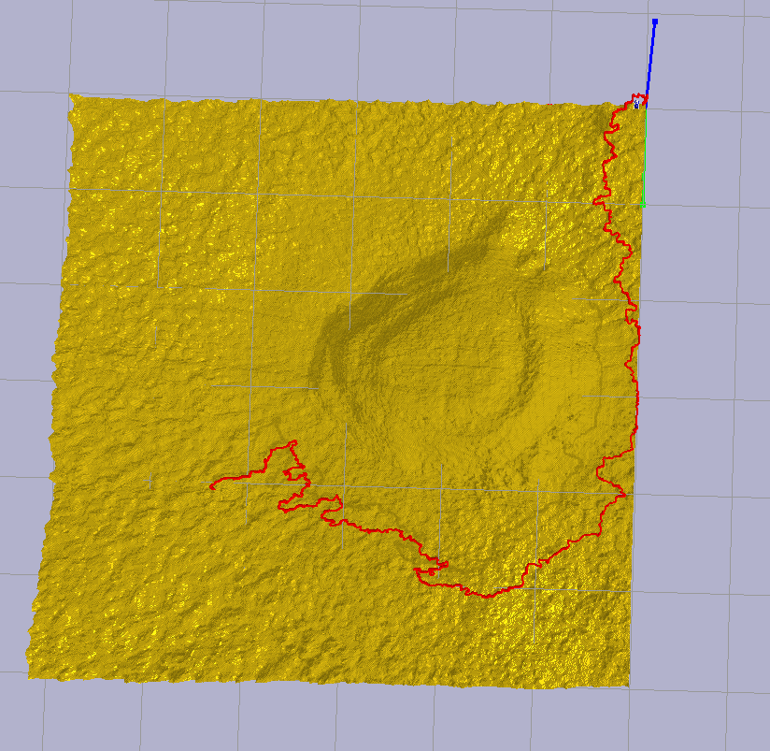
Path generated

Slide 31
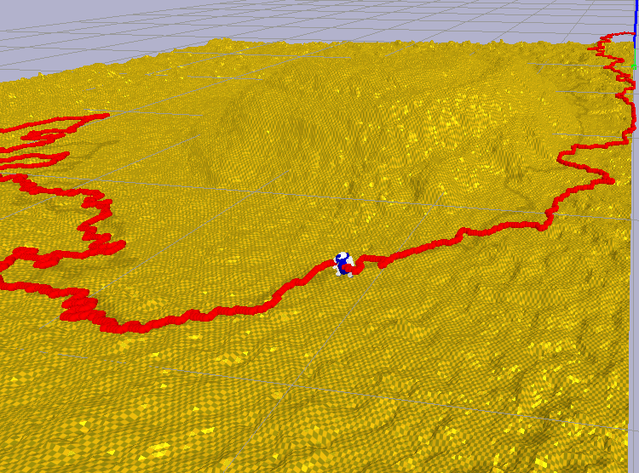
Path Visualization of the Mars Rover Traversing the surface. (**some bugs exist)

Slide 33
Live Demonstration

Slide 34
Special Characteristics
A good chuck of my code is vectorised.
This makes it better than some computations done by QGIS which is incredibly slow and does not utilise the GPU.
The 3D visualisation is also fast to generate.

Slide 35
Limitations
Coarseness of data and prone to error
The data used for calculating the main trajectory is taken from the HiRISE dataset.
This is the highest resolution available to us. However, this is still 1m per pixel, making it hard for small rovers to navigate accurately based on the terrain data.
However, big robots with bigger wheels would have less problems with this.

Slide 36
Limitations
2. Slow speed for plotting path
The overlayed path on the 3D visualization takes a while to plot because individual elements in the environment are created. This can be reduced by using prefabs.

Slide 37
Limitations
3. Inaccurate physics for the Mars rover
Due to resource constraints, I was not able to achieve very accurate physics of the rover while it traverses the terrain. Hence, I made the robot make a flyby just over the terrain in a sequential manner to simulate the process.

Slide 38
Limitations
4. Only includes support for Raster Data
My project only includes support for raster data to be included to calculate the trajectory of the rover. Any vector data needs to be rasterized (leading to some possible errors in the process)

Slide 39
All code hosted on GitHub
https://github.com/anshium/spatial-informatics-project

Slide 40
Resources
In addition to the sources of data mentioned previously,
https://mars.quickmap.io/
was helpful for CRISM data.

Slide 41
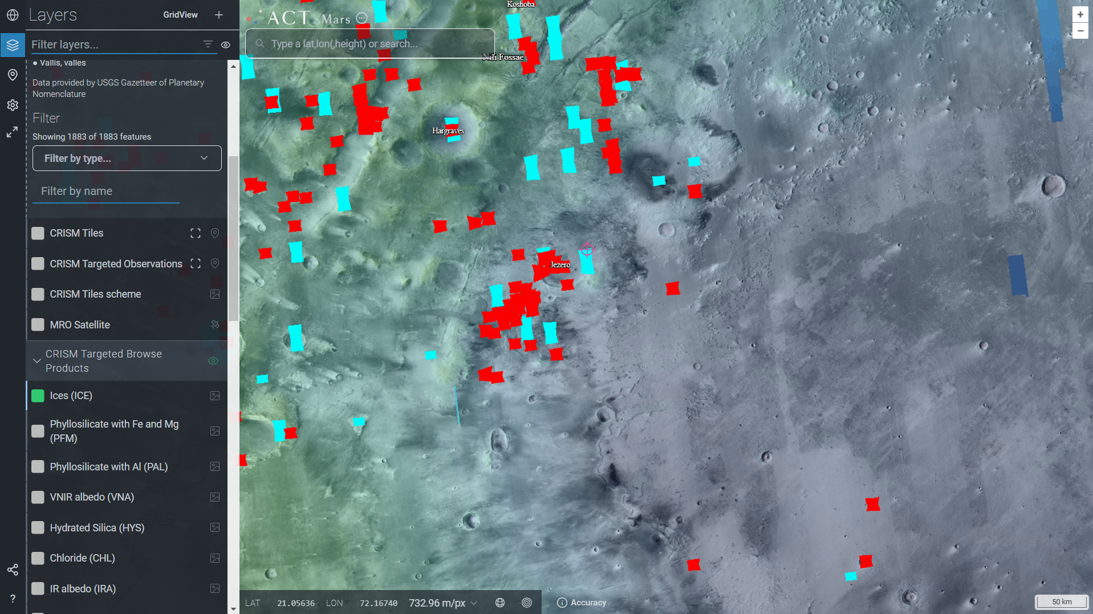
Resources
In addition to the sources of data mentioned previously

